Slide 1
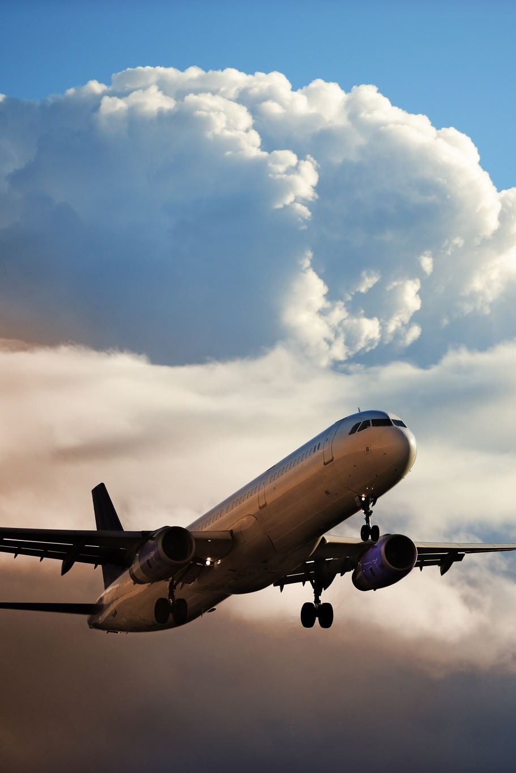

Twitter Sentiment Prediction of US Airlines
Group-12: Amitoj Singh Kohli and Aryaman Kakad
Graduate Student, College of Engineering, MS in Data Analytics Engineering, Northeastern University, Boston, MA
Xuemin Jin
Teaching Professor, Mechanical and Industrial Engineering
IE7275 Data Mining in Engineering
Holmes Hall 339, Conference Center
April 19th , 2023

Slide 2

Business Problem Definition
Airline companies in the United States face a significant challenge in understanding and managing customer satisfaction.
Negative sentiment towards an airline can lead to decreased bookings and revenue.
Social media platforms, such as Twitter, provide extensive customer feedback on airline service quality that can be used to gain insights into customer sentiment toward the airlines.
However, the sheer volume of data can make it challenging to manually analyze and understand the overall customer sentiment.
Problem Objective
The project aims to predict the sentiment of tweets about US airlines using supervised machine learning techniques.
It will understand customer perceptions and predict the sentiment of tweets as positive, negative, or neutral.
This model will help airlines make data-driven decisions to identify areas of improvement and tailor their services to meet customer needs better.

Slide 3
About the Dataset
Dataset is obtained from Kaggle, and the link is dataset link.
The original source of this data is Crowdflower's Data for Everyone library.
The dataset contains tweets expressing positive, negative and neutral sentiments towards 6 US Airlines. The 6 US airlines are American airline, Delta, US airways, United airline, Virgin airline and Southwest airline.
The data contains tweets from users from the date 16th February 2015 to 24th February 2015 i.e., 9 days of tweets from users.
The tweets on a specific day are as follows: 4, 1408, 1344, 1376, 1500, 1557, 3079, 3028 and 1344 for these 9 days.
The shape of data frame is (14640, 15).
Solution Design
Cleaning and preprocessing the data for various data issues / error pattern.
Present the insights clearly and concisely using data visualization techniques.
Training a supervised machine learning model using labeled data on sentiment.
Using the trained model to predict the sentiment of tweets about US airlines.
Continuously evaluate the model's performance and make necessary improvements.

Slide 4

Data Pre-Processing
How did we handle missing values?
Three columns, that is, ‘airline_sentiment_gold’, ‘negativereason_gold’, and ‘tweet_coord’ are having more than 90% of missing values. These columns do not contribute to determine the dependent variable ‘airline_sentiment’ and therefore it is deleted.
How did we handle outliers in our dataset?
We only have 4 numerical predictors in our dataset out of which one is the tweet id which is a unique value for each of the tweet in our dataset.
Columns such as 'airline_sentiment_confidence' and 'negativereason_confidence' have values between 0 and 1 to determine how confident each of the user was in tweeting their tweet about the airlines and about the tweet itself.
The last numerical predictor is retweet count which contains the number of users who have retweeted a particular tweet and it is a discrete value so no possibility of an outlier.
How did we use an unbalanced dataset?
The dataset after cleaning and pre-processing the text using TF-IDF vectorizer. We converted the resultant matrix to a dataframe and merged columns like 'airline_sentiment_confidence', 'negativereason_confidence', 'retweet_count', 'airline_sentiment’ from the original dataset. Additionally, we dropped the rows which had missing values.
In the process of dropping null rows, the dataset became unbalanced. To deal with this issue, we have used a function called ‘compute_class_weight’ which as it states computes the weight of each class. This variable was then used in ML models like Logistic Regression, Random Forest Classifier and Support Vector classifier.

Slide 5
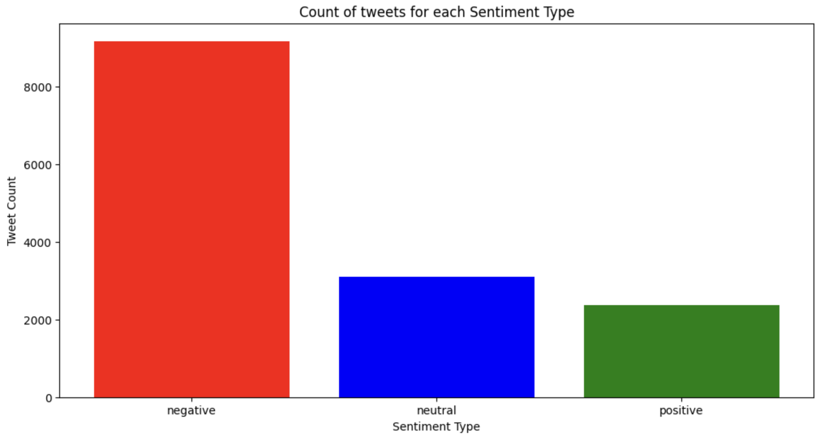
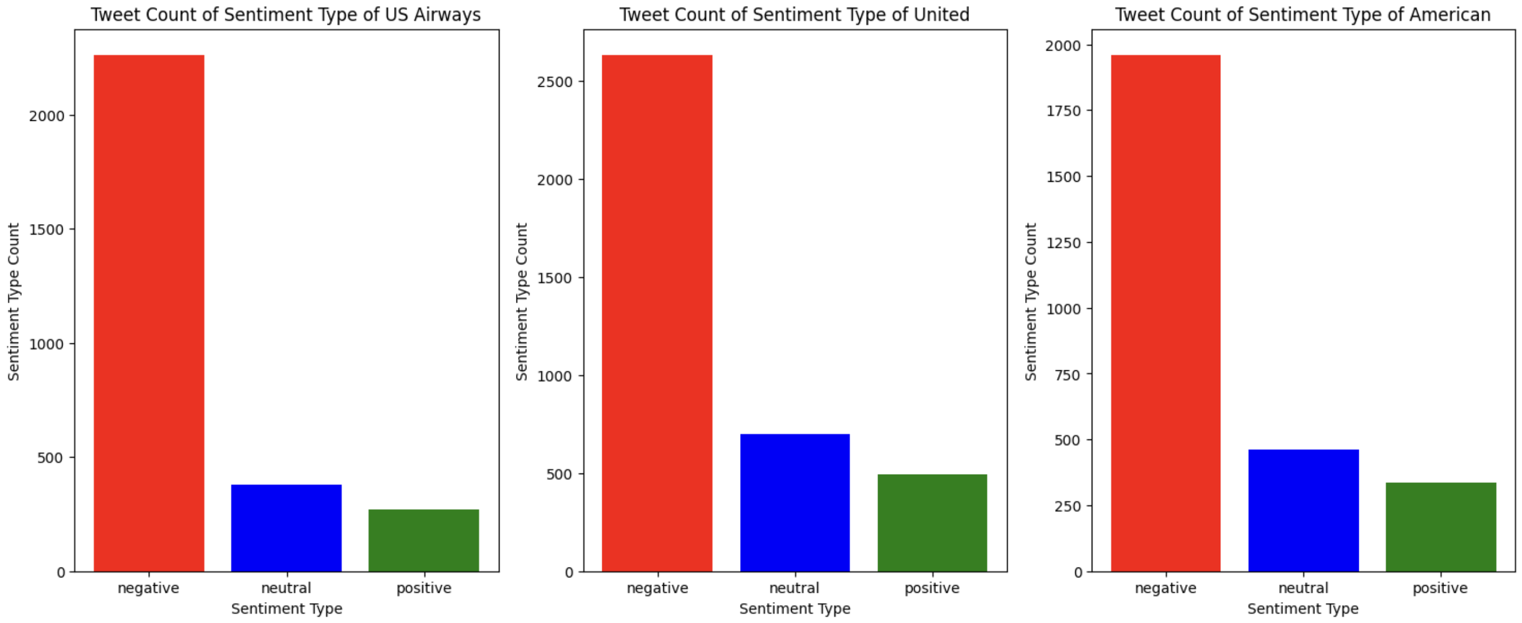
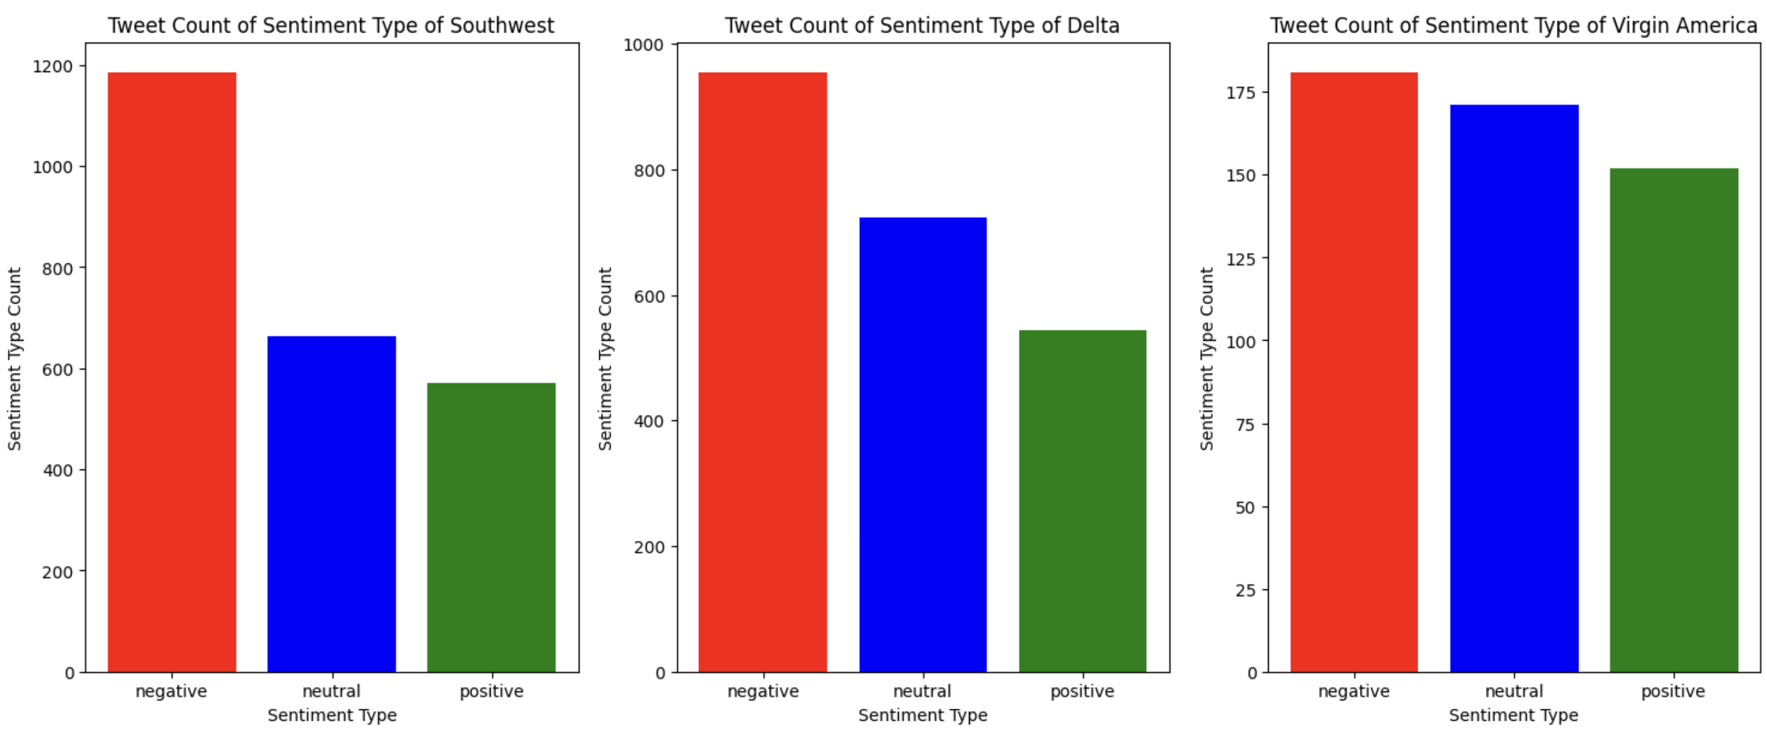
Data Exploration and Visualization
It appears that many individuals are not enjoying their flights as much as they used to.
As a result, it is crucial to identify which airlines are excelling at satisfying their customers and which are falling short.
To accomplish this, we will analyze the proportion of negative reviews for each airline.

Slide 6
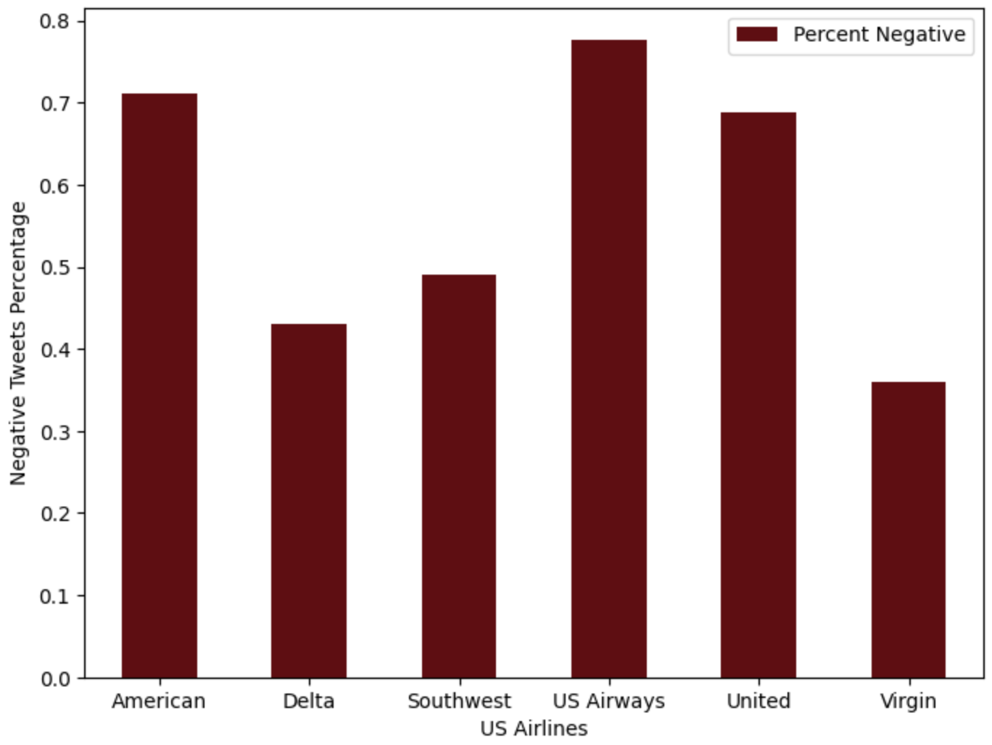
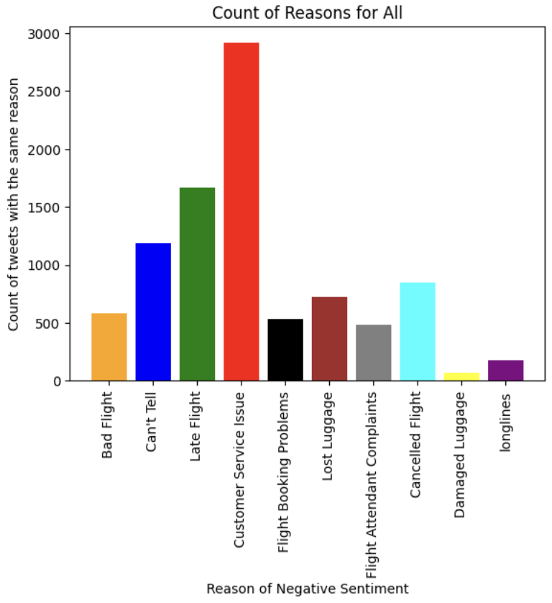
Data Exploration and Visualization (Cont.)
Southwest Airline has the most balanced reviews in terms of sentiment of the customers experience.
US Airways have around 80% of negative sentiment from the customers flying in their airlines.
Among the 6 airlines, Virgin Airlines seems to be the best in terms of sentiments from the customers.
The top 5 negative reasons are:
Customer service issue
Late flight
Can’t tell
Cancelled flight
Lost luggage

Slide 7
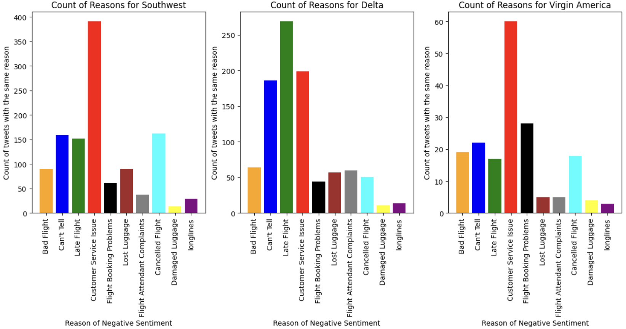
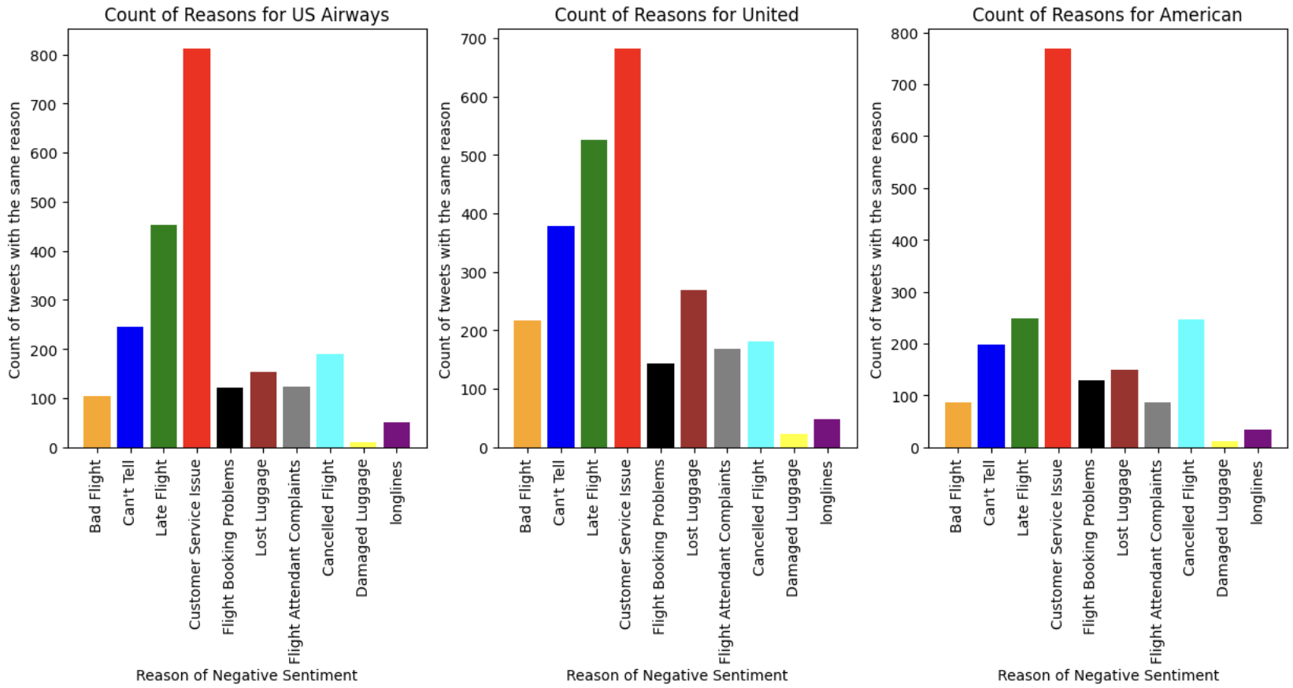
Data Exploration and Visualization (Cont.)
Delta Airline's main reason for negative sentiment is Late Flight.
The main reason for negative sentiment for US Airways, United, American, Southwest, Virgin America is Customer Service Issue.
Virgin America Airline's highest count for each of the negative sentiment reason is not more than 60.
Unlike Virgin America, airlines such as United Airline, US Airways, and American Airline are burdened with over than 500 count of negative sentiments, ranging from delayed flights to poor customer service.

Slide 8
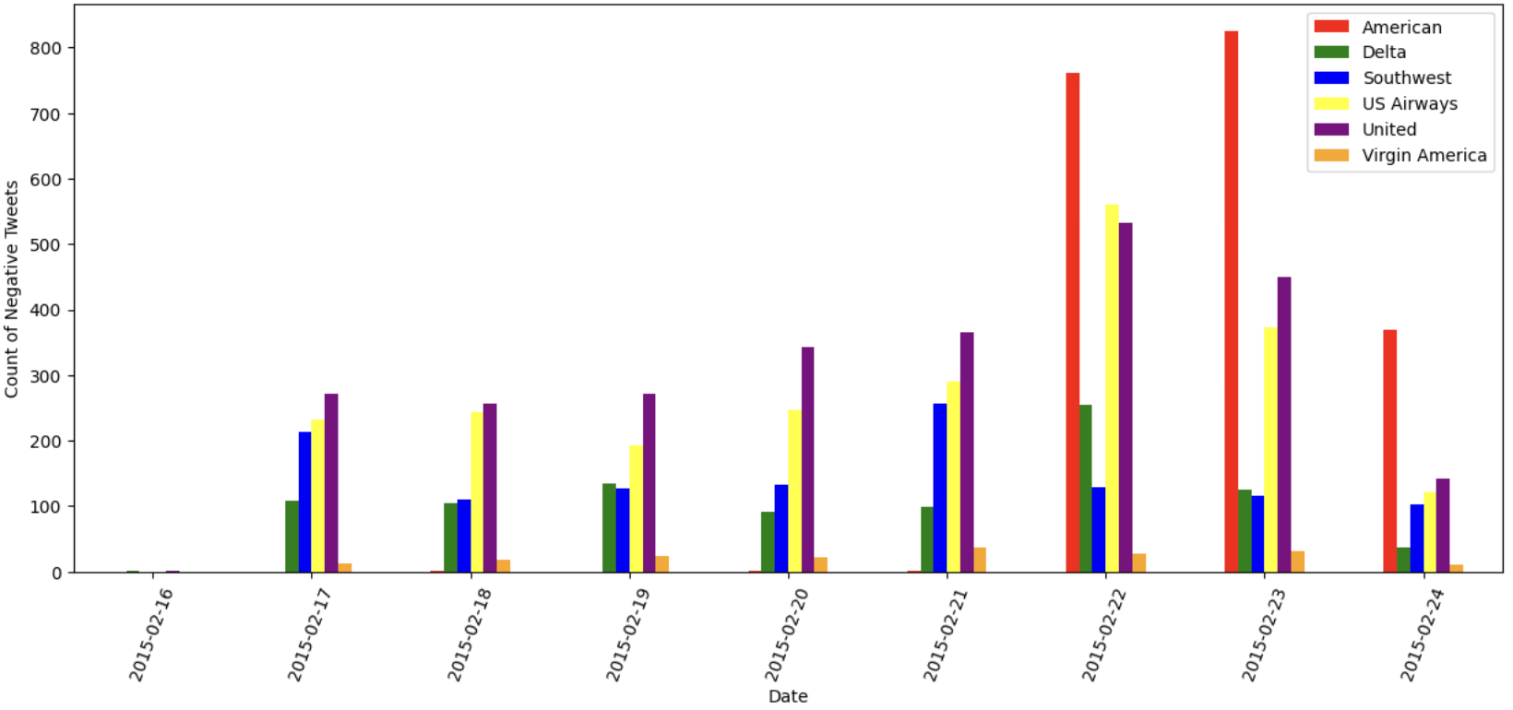
Data Exploration and Visualization (Cont.)
Relationship between the Date and Negative Sentiment
By visualizing the date's impact on tweet sentiments (especially negative ones!), we can derive diverse conclusions. It'll be captivating to observe whether the date influences the tone of tweets.
The rest of the airlines had a slightly higher proportion of negative tweets towards the end of the week.
In contrast, Virgin America had the fewest negative tweets compared to other airlines in the weekly data, which could be due to their significantly lower total number of tweets.
On February 23rd, 2015, there was a sudden surge in negative sentiment tweets directed at American, but it decreased by half on the following day. Hopefully, American has since improved their customer service issues.

Slide 9
Machine Learning Models
As our problem is related to Classification Supervised Machine Learning. We have applied seven techniques related to classification supervised learning.
1. Naïve Bayes Classification 2. Random Forest Classification 3. Logistic Regression 4. K-Nearest Neighbors Classification
5. Support Vector Classifier 6. Linear Discriminant Analysis 7. Neural Network
We have presented the training and validation accuracy of each of these models as well as the classification summary which includes accuracy, precision, recall and f-1 score.
We have also plotted the Precision vs Recall graph and ROC-AUC Curve for each of the models to decide which out these 7 model is the best for our classification problem.

Slide 10
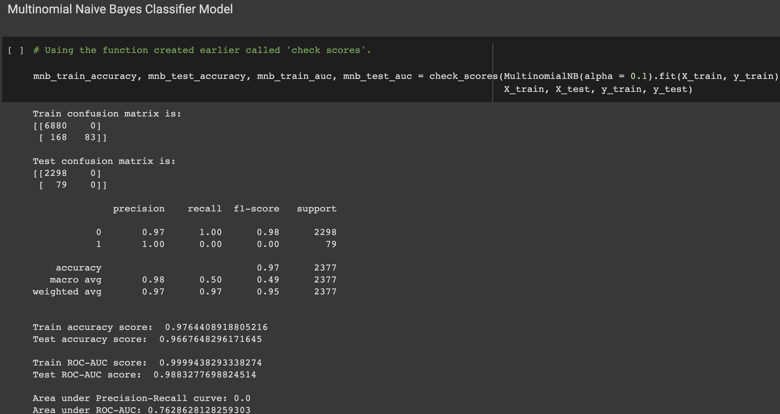
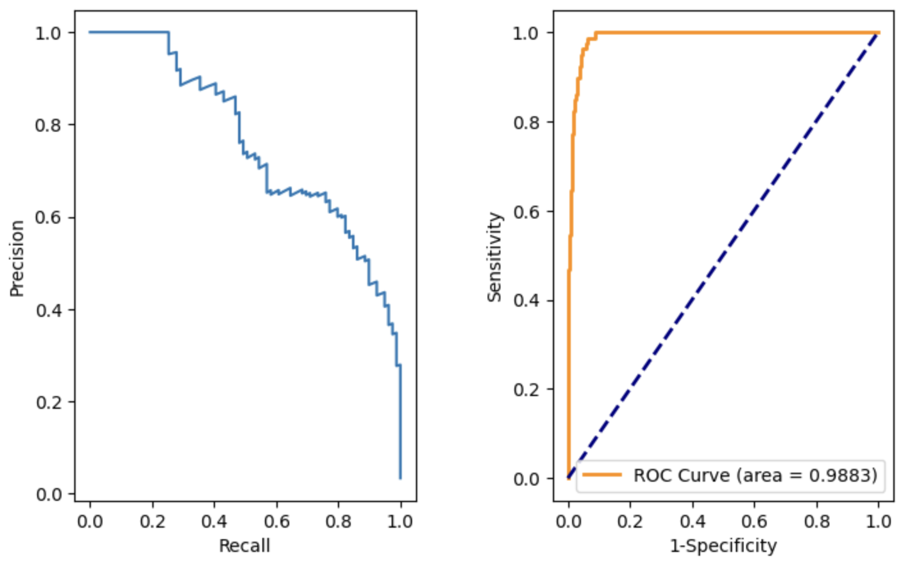
Naïve Bayes Classification

Slide 11
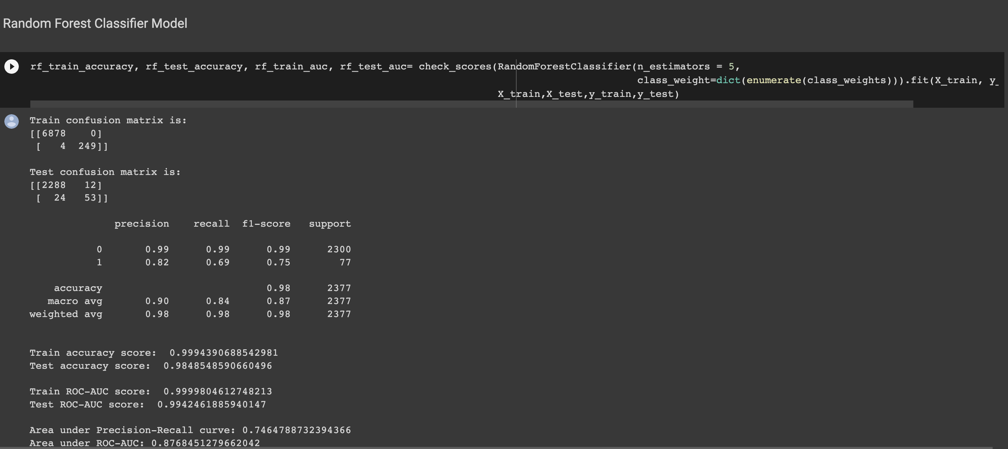
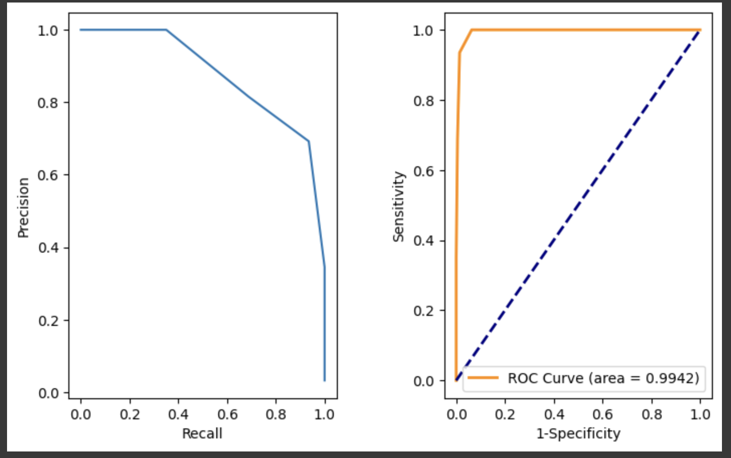
Random Forest Classification

Slide 12
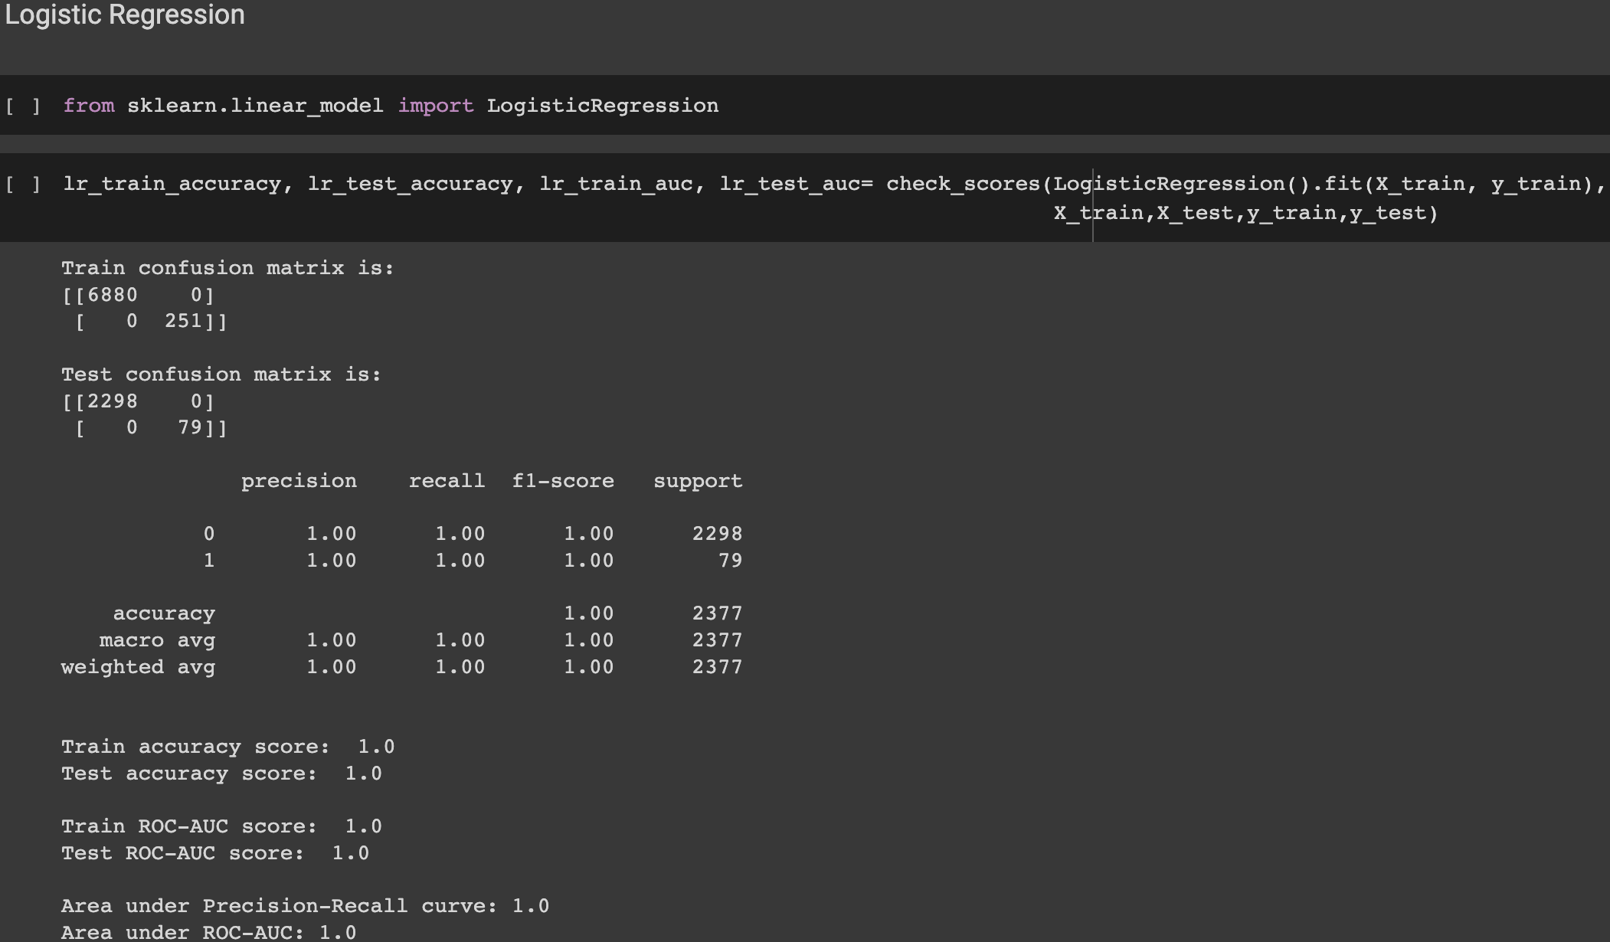
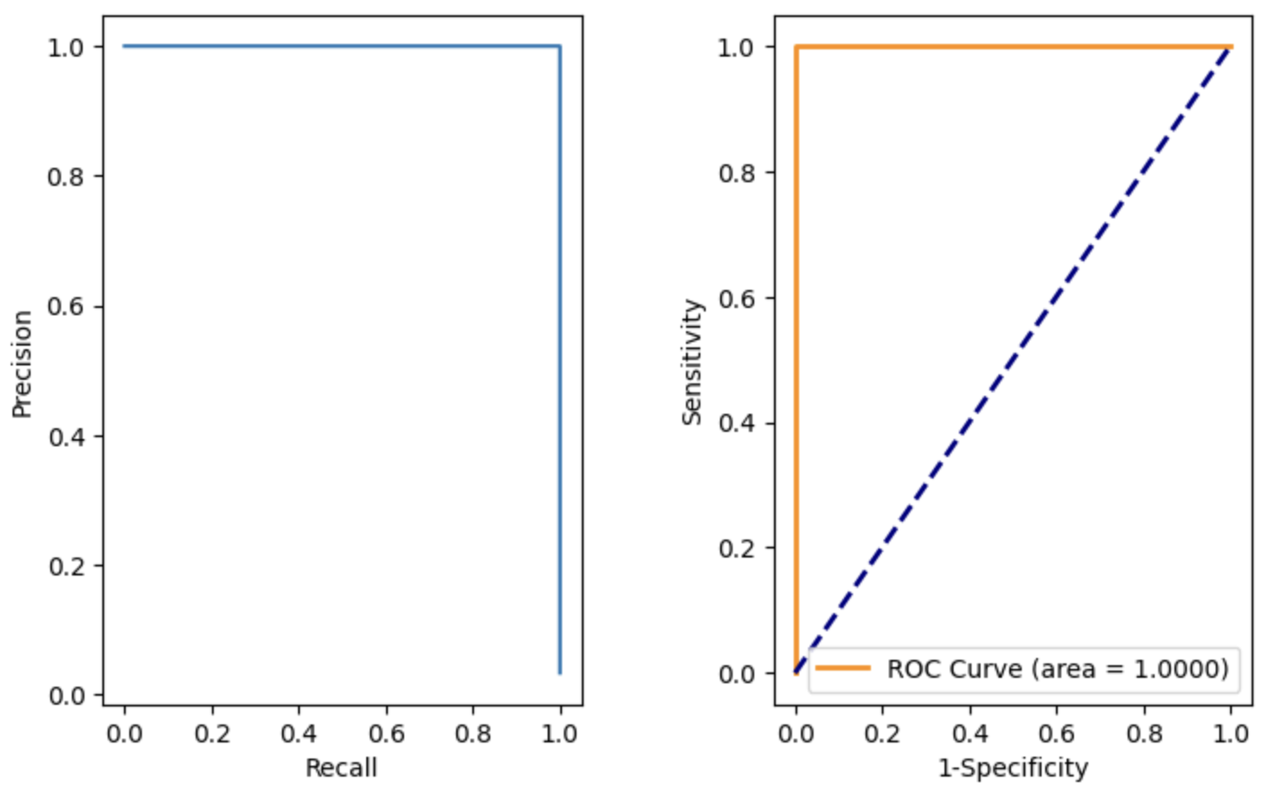
Logistic Regression

Slide 13
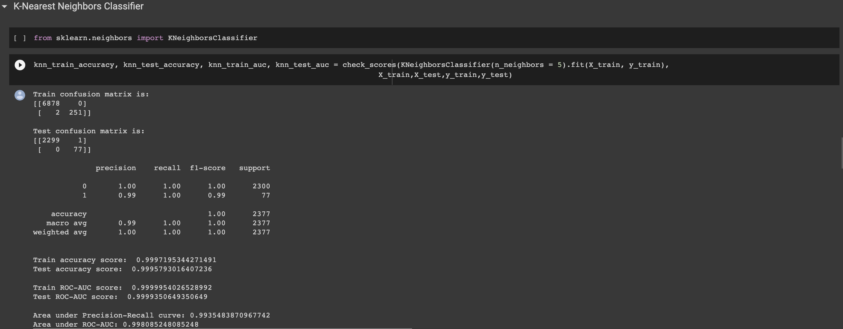
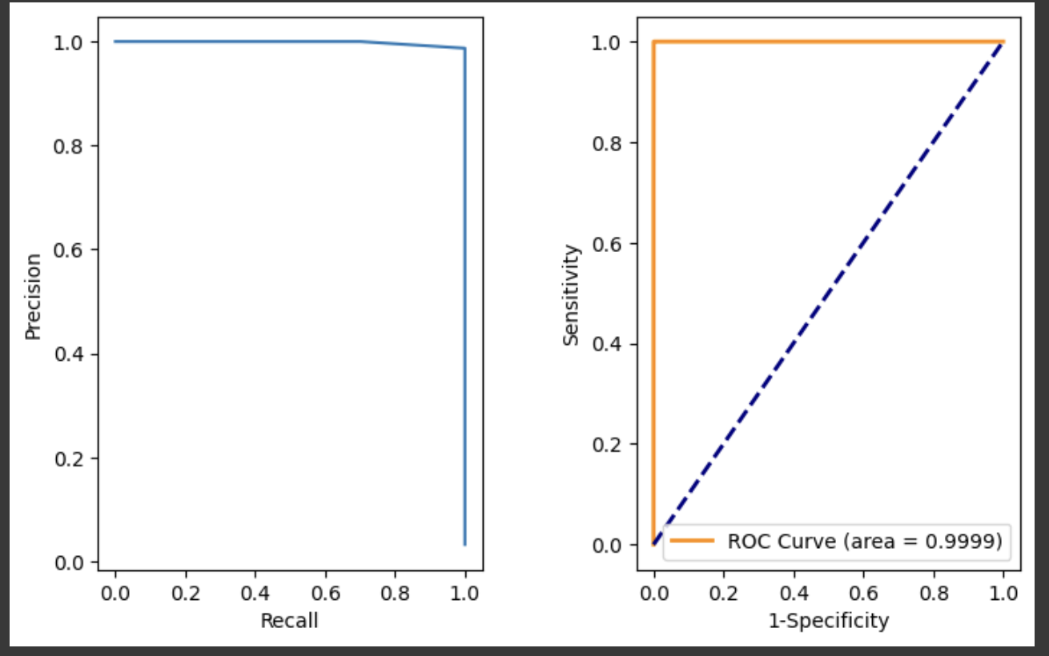
K-Nearest Neighbors Classification

Slide 14
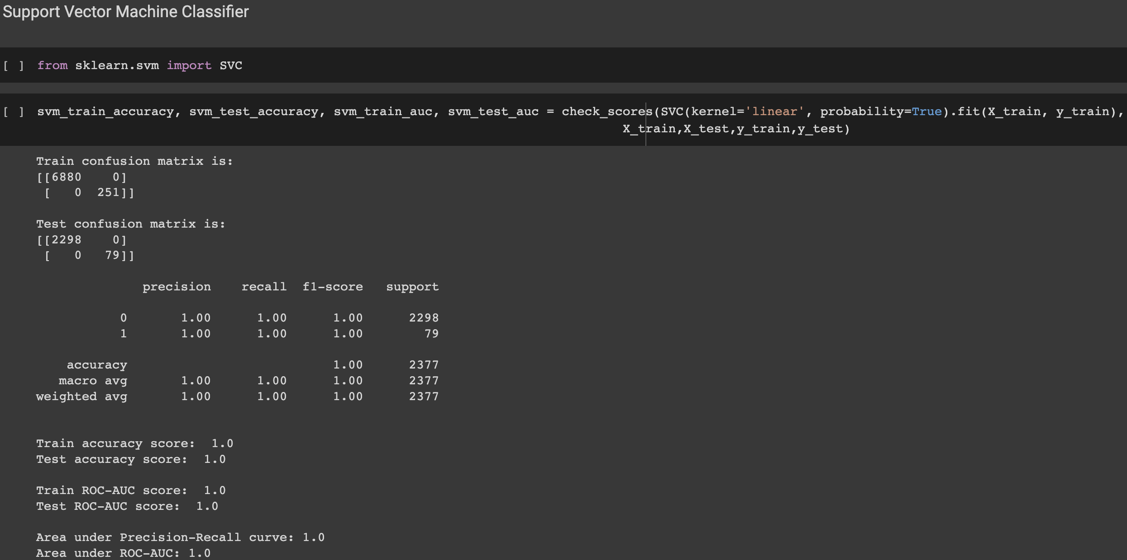
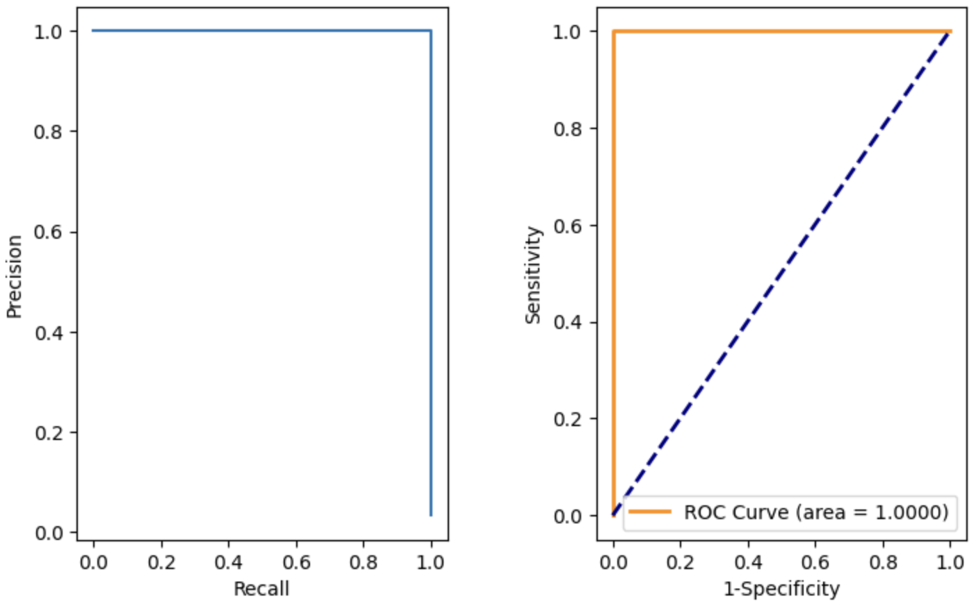
Support Vector Machines

Slide 15
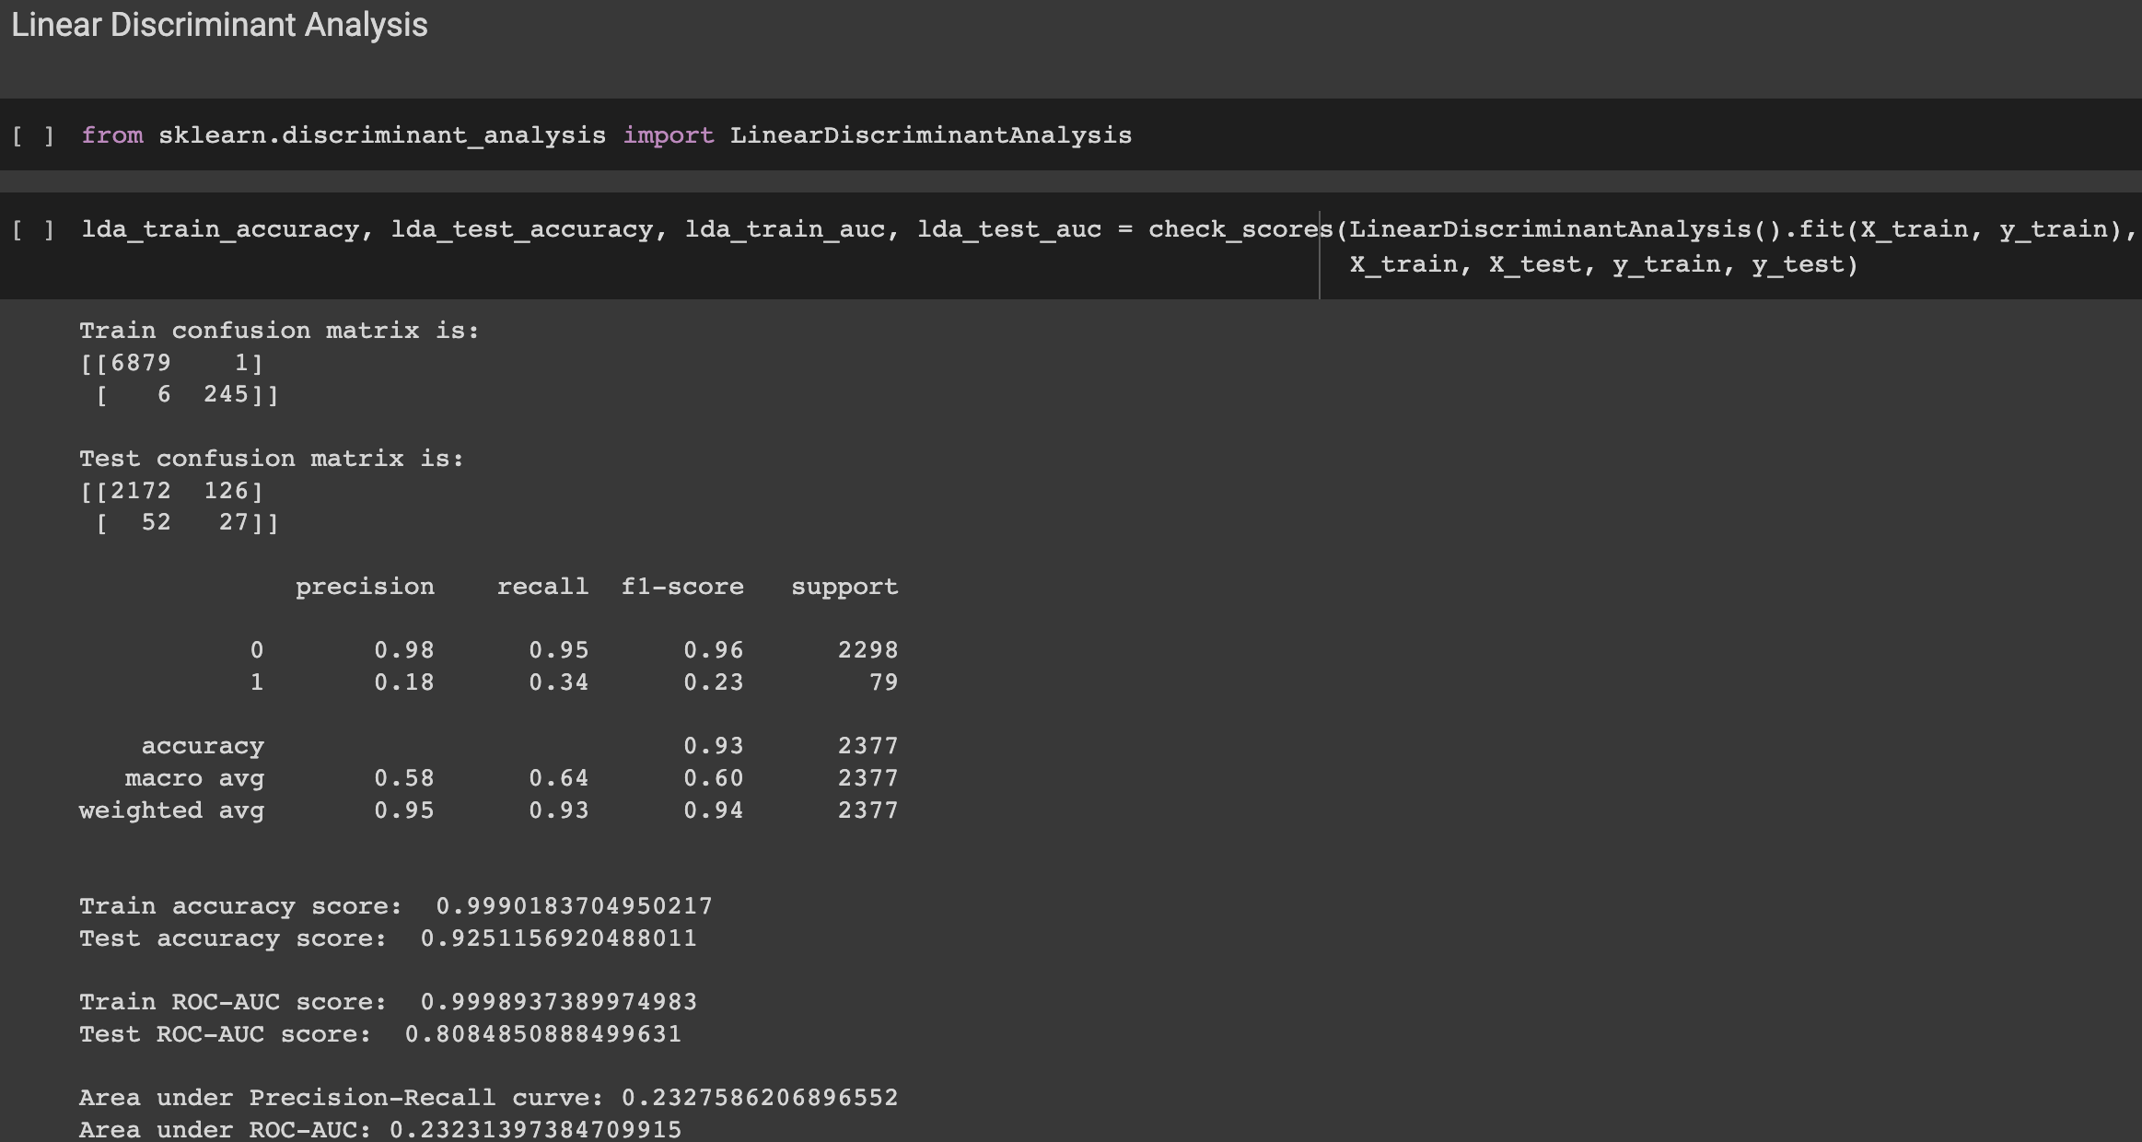
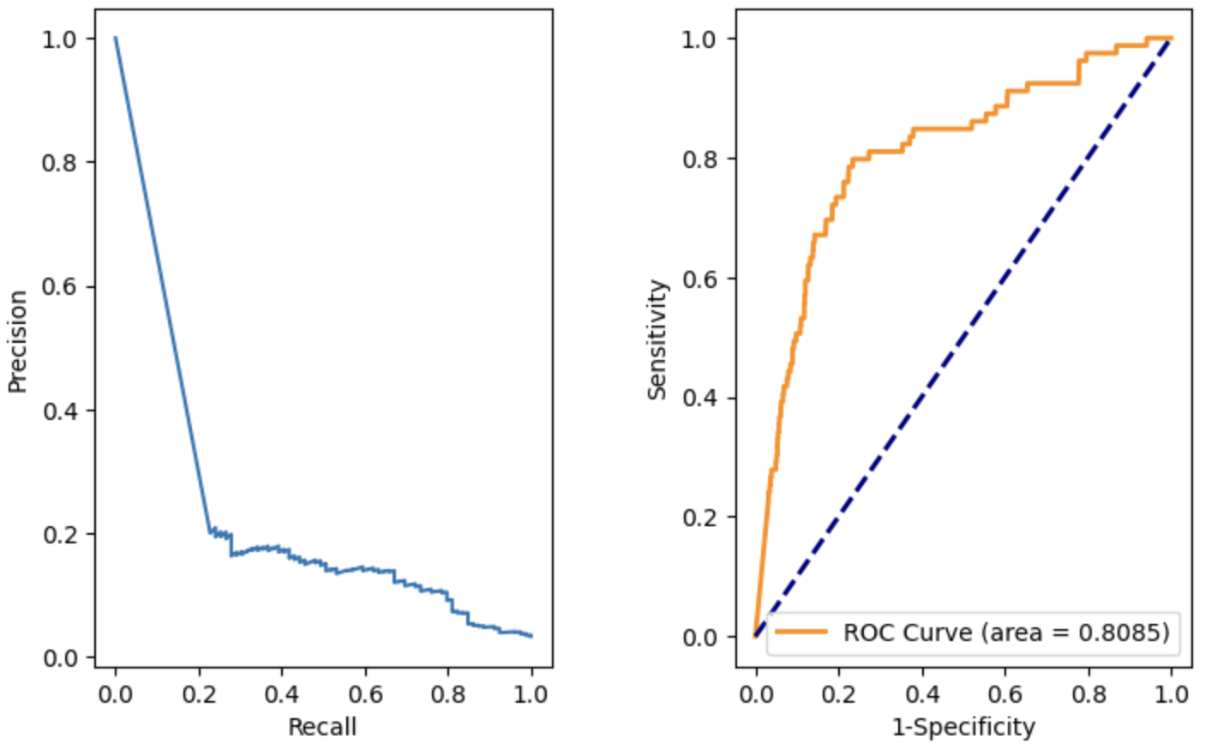
Linear Discriminant Analysis

Slide 16
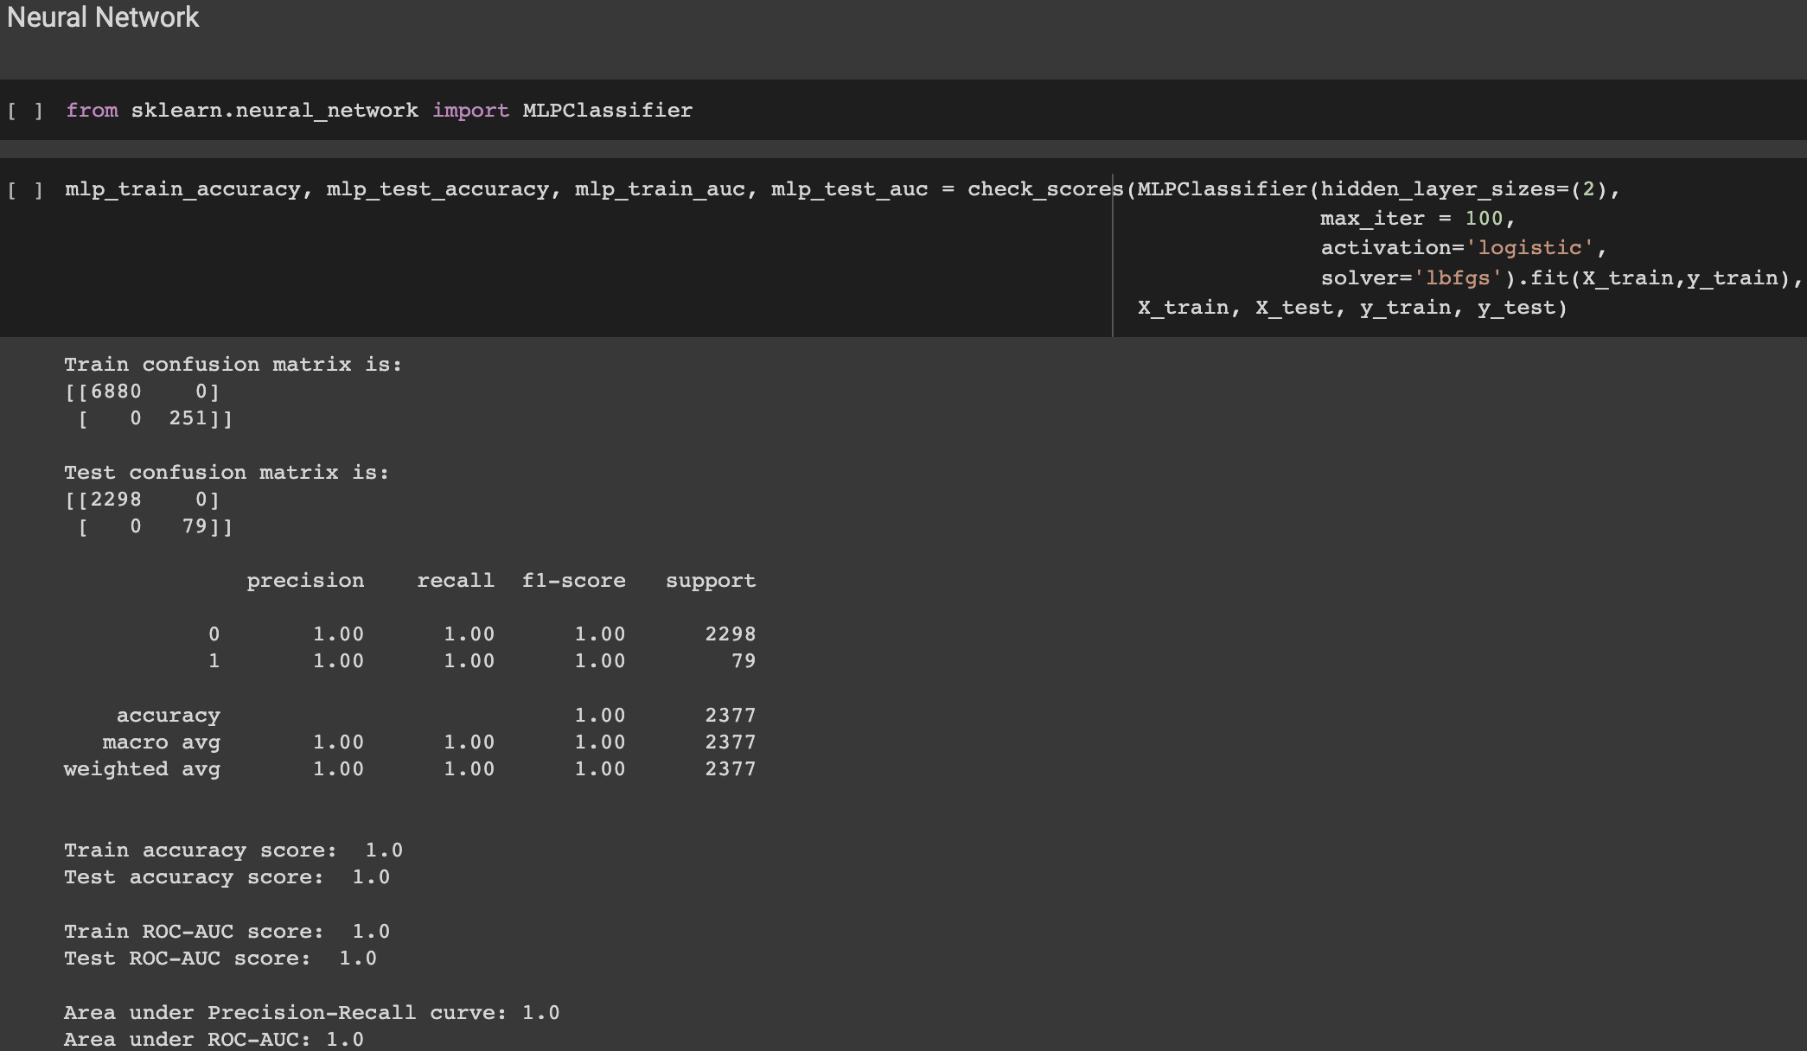

Neural Network

Slide 17
Results and Conclusion
After looking at performance evaluation metrics like F-1 score, Accuracy, Precision, Recall and the ROC-AUC curve, we can say that the top 3 models for our project is Logistic Regression, Support Vector Machine(Classifier) and Neural Network.
One of the major reason for an accuracy of 1 for these 3 models, is because of the dataset being imbalanced. When using a TF-IDF vectorizer, it creates a sparse matrix containing 1’s and 0’s, therefore it is very easy for some of the classification models to classify the sentiment of the analysis as positive or negative based on the words used in the tweet.
The TF-IDF gives normalized term frequency values, which helps to reduce the impact of high-frequency words that may not be beneficial for class distinction. SVC and LR's linear character makes them ideally suited for text classification tasks, since the relationships between features are frequently described using linear functions.
Potential Improvements
Potential improvements for this project can be to use a dataset that contains tweets for US airline passengers for more than 9 days which gives us an increased probability to make a robust classification model which does not over-fit on the data.
One key factor to investigate while selecting a dataset should be the nature of the dataset in terms of class labels. It would be highly beneficial to select a dataset which is balanced in nature in terms of it’s class labels.
Another improvement could be using additional classes like Strongly Agree, Agree, Neutral, Disagree, Strongly Disagree so that the US airlines can address issues based on the priority of each of these classes.

Slide 18
Thank You!

